Slide 1
Reactive Programming
Brief History of Interactive Programming
Observer Pattern
Interfaces

Slide 2
A Brief History of Interactive Programming
1970: Console Programming – Synchronous
1980: Polling GUI events – Synchronous
1990: Event handlers – Asynchronous
2010: Reactive Programming – Asynchronous

Slide 3
Console Interaction
Console interaction is synchronous
Synchronous means that the program will wait until the user interaction finishes before moving on in the program
Example console program:
Enter your name:
>Alice
Enter you age:
>25
Alice is 25
Program waits
print("Enter your name: ");
name = readLine();
print("Enter your age: ");
age = readLine();
print(name + " is " + age);
Program waits

Slide 4
Synchronous programming
Synchronous programming is generally simpler and predictable
No code is executing while waiting for the user's input
The program pauses exactly where the request for user input occurs
No further programming constructs are required

Slide 5
Early GUI event handling
GUI user interfaces are naturally multimodal, this means that the user can do many things with the user interface, e.g. press buttons, type in text fields, switch windows
The user interface is not waiting for a single input, there may be many different types of input
The initial approach to handling user events was an event loop

Slide 6
Event loop
With an event loop the program is still in full control
It constantly loops and checks for new events
When a new event occurs it checks the type of event and executes a response accordingly, synchronously
while (true) {
event = getNextEvent();
switch (event) {
case mouseButton:
processMouseButton();
break;
case textEntered:
processTextEntered();
break;
}
}
}

Slide 7
Event Handlers
Because event loops became the standard way to process events the approach was abstracted to event handlers
In reality a framework used by the program has a built-in event loop
The program can register event handlers (functions) with GUI objects
The framework will determine which GUI object has been interacted with and call the appropriate registered event handler (if one has been registered)
This approach is asynchronous because between event handler calls, your program no longer controls the flow of execution

Slide 8
Reactive Programming

Slide 9
Why reactive?
Asynchronous programming can be significantly more complex than synchronous programming and can introduce a number of issues
One issue is maintaining a consistent state
For example two different event handlers may modify views and data independently resulting in the view being inconsistent with the data
Reactive programming aims to provide a conceptual approach to asynchronous programming to simplify asynchronous programming and mitigate some of these issues

Slide 10
What is reactive programming?
In imperative programming a = b + c, would calculate the result of b + c and store it in a once, and would no longer be affected if b or c change in value unless the line of code is executed again
In reactive programming a = b + c, would continually update the value of a as b or c changes

Slide 11
Binding
We have encountered binding in Angular
Binding is an example of reactive programming
When we include a component variable in a template, Angular binds the variable
When the variable value changes the HTML will automatically update
This is a specific example of reactive programming
e.g.:
{{a + b}}

Slide 12
Observer Pattern

Slide 13
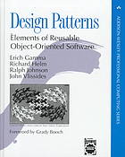
Patterns
A Software Design Pattern is a reusable solution to a commonly occurring problem
It is similar in concept to an algorithm, but generally is focussed on the software architecture rather than the procedural execution
Software design patterns were popularised by the Gang of Four in 1994: Gamma, Helm, Johnson, Vlissides
Common design patterns used in OOP proposed in the GoF Design Patterns book include:
Factory methods
Singleton

Slide 14
Observer Pattern
The observer pattern was also presented in the GoF Design Patterns book
The observer pattern promotes low coupling between objects
The observer pattern is related to the publish/subscribe pattern
A subscriber can subscribe to changes made by the publisher:
The subscriber registers (subscribes) with the publisher
The publisher adds the subscriber to its subscriber list
When a change occurs, the publisher sends a message to each subscriber with information about the change that occurred

Slide 15
Observer pattern
In the observer pattern, the publisher is the subject and the subscriber is the observer
Observer1
Subject
Broadcast changes
Observer2
Observer3

Slide 16
TypeScript Observer Pattern Example

Slide 17
TypeScript Observer Pattern Example
In the next few slides we will write our own observer pattern example using TypeScript classes
We need two classes: Subject and Observer
The subject will contain a list of observers as well as a value that can be changed
When the value is changed the subject will notify all of the observers in its list

Slide 18
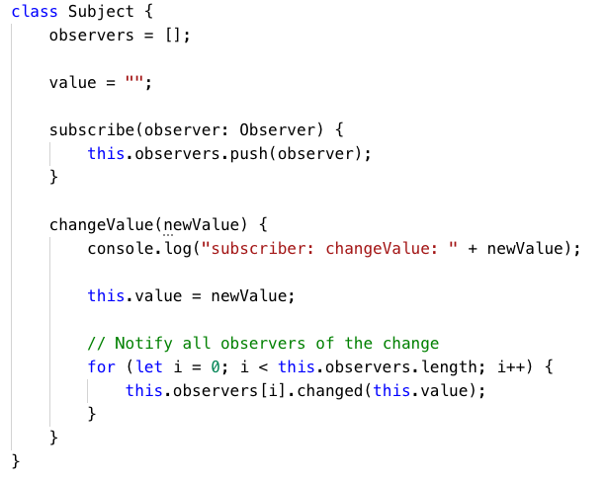
Subject
Notes:
changes each of the observers “changed” method is called with a new value.

Slide 19
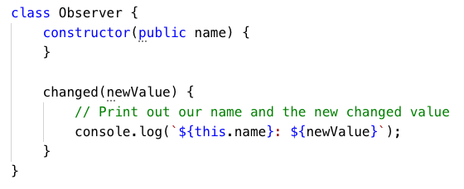
Observer
Remember that public constructor parameters become members of the class
Notes:
only need a “changed” method will do something with the data each time it gets called.

Slide 20
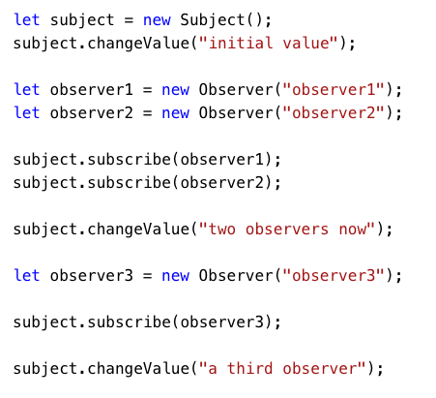
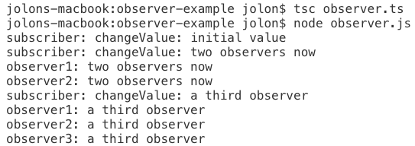
Example usage and output
Output:
Notes:
is create and subscribes. The subject value changes and the new value is now pushed to all three observers.

Slide 21
Interfaces

Slide 22
Interfaces
In the previous example, all of the observers did the same thing because they use the same class and changed() function
In reality each observer will respond to the changed message differently
One way that we can support different types of observers is to use an interface

Slide 23
Interface
An interface is like a class but with no implementation
An interface defines what methods a class should have that implements the interface
The object may be different, but the interface is the same
Object1
Interface
Code
Object2
Interface

Slide 24

An Observer Interface
Below is the Observer interface
Note that it is declared as an interface and not a class
It is similar to a class but the method has no body
The interface indicates what methods an implementing class will implement

Slide 25
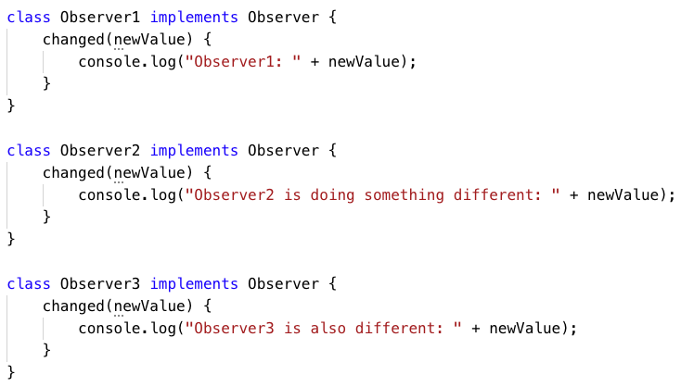
An Observer
We can now make as many Observer classes that we like that implement the Observer interface
If a class indicates that it implements an interface, it must provide implementations for all of the methods in the interface:

Slide 26
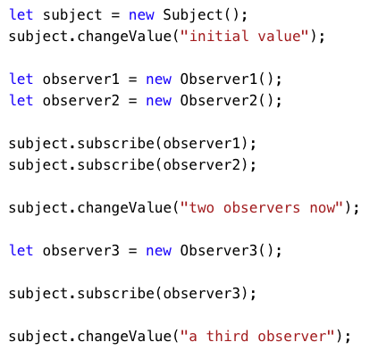
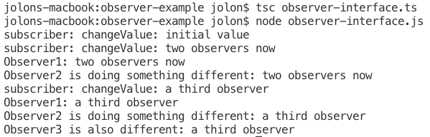
Example usage and output
Output:
Notes:
of our example now changes as each observer has a custom output for its changed method.

Slide 27
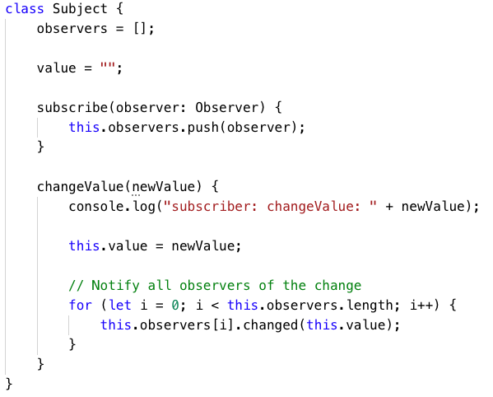
Observer interface
Note that the Subject class didn't change!
The Observer interface is a type and we can use it where we might use a class

Slide 28
Observer Interface
Observer1
Observer
Subject
Observer2
Observer
Notes:
have each observer implementing a observer interface.

Slide 29
Implementing multiple interfaces
A class can implement multiple interfaces
The below example has a class implementing two interfaces:
interface Add {
add(a, b);
}
interface Subtract {
subtract(a, b);
}
class Arithmetic implements Add, Subtract {
add(a, b) {
return a + b;
}
subtract(a, b) {
return a – b;
}
}

Slide 30
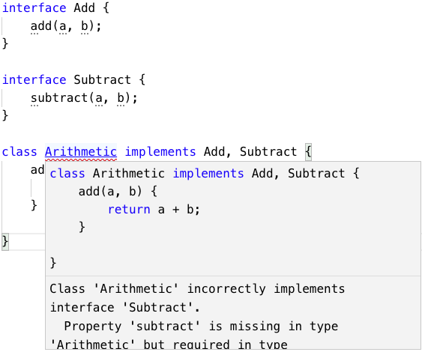
Interface errors
If a class specifies that it implements an interface it must implement the methods of the interface otherwise it will be an error:

